Slide 1
6-5-4 (or Ship, Captain, and Crew)
Connor Demorest
11/15/2020

Slide 2
Research Question
What is the probability of “qualifying”?
What is the expected score given qualification?
What is the probability of winning?
What is the best strategy to play with to win money?
Notes:
Research Question
Define qualify later

Slide 3
Intro: How to play the game
Figure 1: Flowchart of game algorithm
Roll Dice
No 6 showing
Have die with a 6
Roll Again
(5 dice)
Pull 6 out of available dice
No 5 showing
Have die with a 5
Roll Again
(4 dice)
Pull 5 out of available dice
No 4 showing
Have die with a 4
Roll Again
(3 dice)
Pull 4 out of available dice
If below this line, player “qualified”
Roll dice until choose to stop or reach max # of rolls
Add remaining dice pip showing
Don’t keep score
Keep score
If rolled maximum # of times without getting a 6-5-4, score = 0 and next player rolls
Roll again
(2 dice)
End turn
(Next person rolls)
Notes:
Could picture scenario where a rolls a good score and thinks that score is good enough to win or that they won’t likely improve that score. They should keep the score they have then and pass their turn, instead of rolling again

Slide 4
Methods: How to play the game many times
2 options: Simulate or solve mathematically
Simulation method: write an R function that plays the game once, then do it 10,000 times
Advantages of simulation:
Easy to implement basic rules
Easy to change rules and run again (e.g. change number of dice, change number of sides on dice)
Disadvantages:
Approximate solution
Bugs and errors (foreshadowing!!)

Slide 5
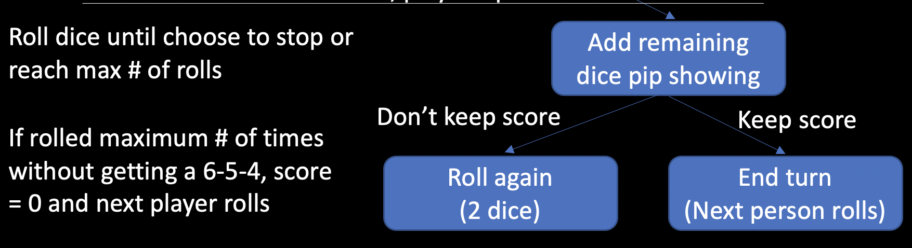
Results: Simulation of 80,000 total games
Recall bottom of flowchart: Choice to keep the score you have or roll again, in some situations
Simulated the game 10,000 times, with different ”rules” to keep a score or not keep a score
No rule to keep a score, so a player would roll 3 times every time they play
Keep a score that would end turn early if they have a score above that cutoff
Plot the differences for each rule

Slide 6
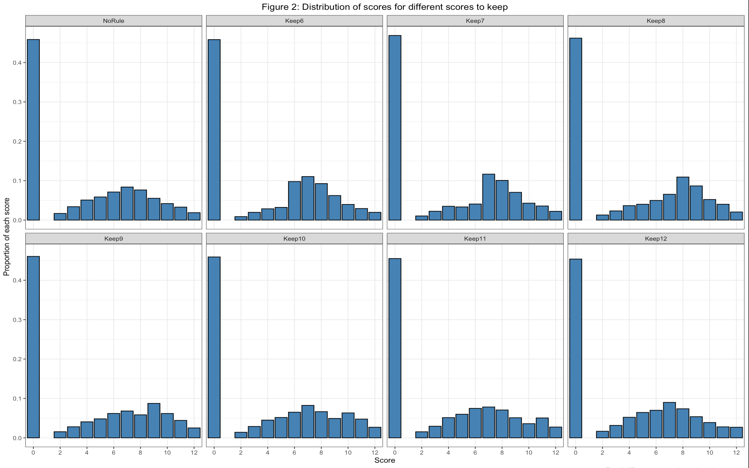
Rules change the distribution of scores
8 rules for keeping scores: No rule, and keep scores that are 6 through 12
Notice differences and similarities in distributions
All distributions on same scale for x and y
X = Score (0-12)
Y = Probability of getting that score (0-0.5)
For all rules of keeping scores, there is around 45% chance of scoring 0 (i.e. not qualifying)

Slide 7
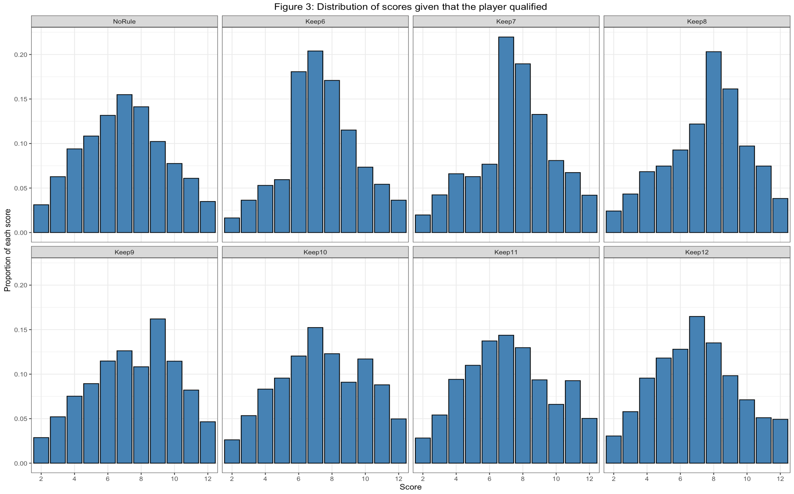
Conditional distributions given qualification
Same plot as before, conditional on not scoring 0
No rule is pretty much triangular
Pretty big shift in probability of scores for different rules
Which of these rules would be best if we wanted to maximize score?

Slide 8
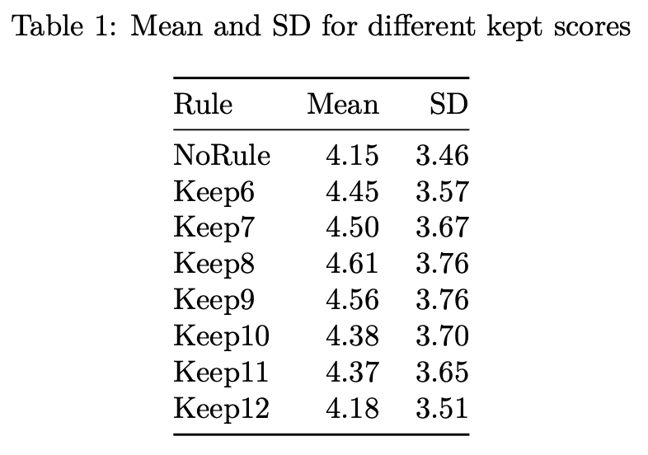
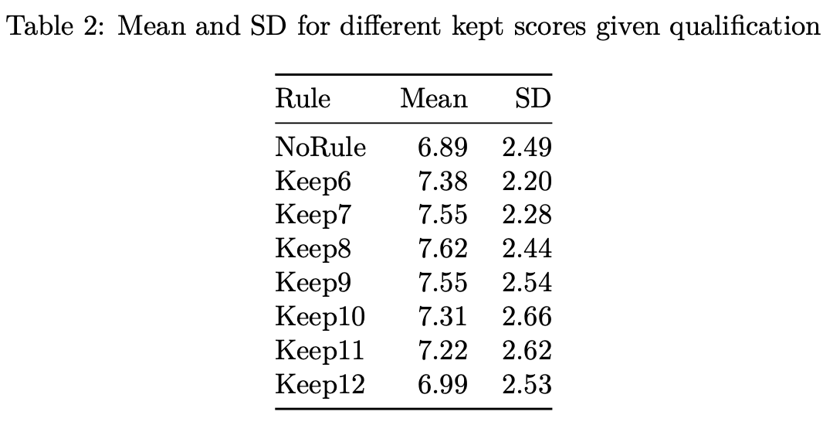
Means and SD of distributions indicate keeping 8 or higher is ideal
Notes:
Note: long run behavior

Slide 9
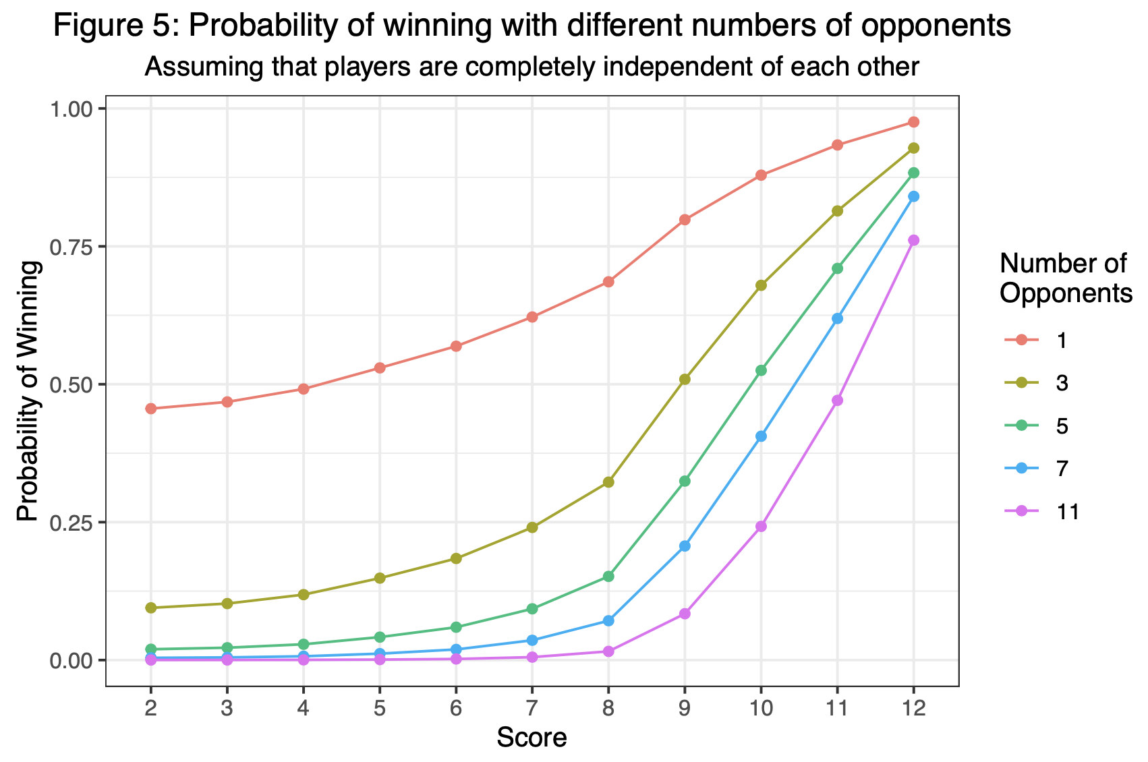
Our goal is not to maximize score, but to win!
The probability of winning is more important
Shows that the score needed to win with any likelihood is higher for more opponents
With 1 opponent, you only need a 4 or higher to win 50% the time
With 11 opponents, you have around 0% chance of winning with a 6 or lower, so you need to take risks to win
No prize for second place!

Slide 10
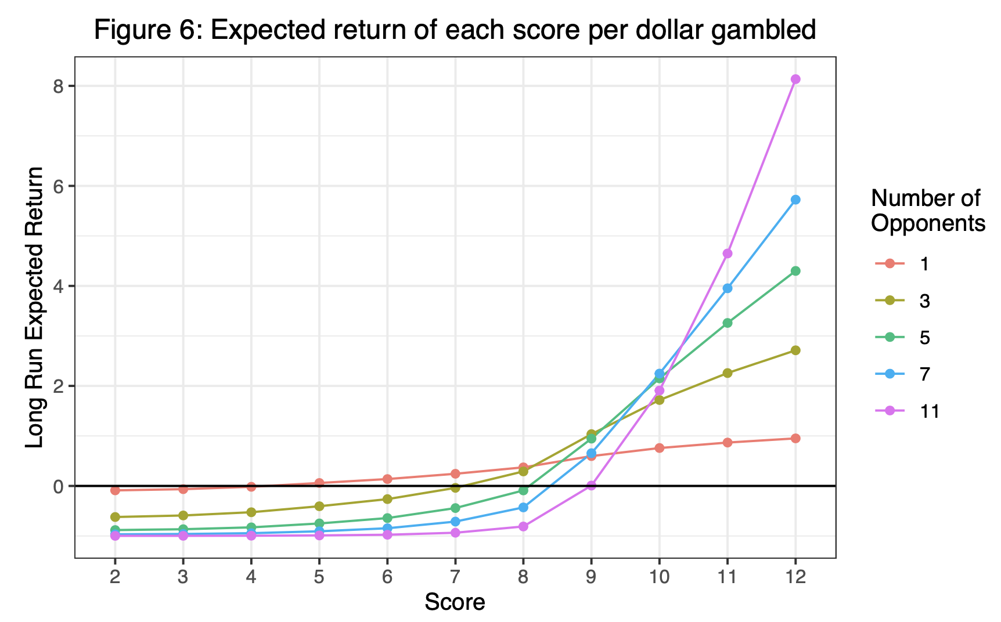
Expected return varies depending on number of players
Plot of expected value on a 1$ bet with different scores of different numbers of opponents
If above the black line at y = 0 making money in the long run
When there are few players no need to take risks
When there are many players, you need to be at 10 or higher to have even 25% chance of winning
The low probability of improving on a score of 9 is outweighed by the size of the pot relative to your bet

Slide 11
All models are wrong, but some are useful (decide for you yourself if this one is useful)
Limitations of the model:
Doesn’t capture how a player would actually play
Doesn’t handle ties between top scores
Situation:
You’re going last, score to beat is 11
You roll 65455 on your first roll
Using ”keep 8 or better” rule, you would keep the 10 and lose.
In real life you would roll again to try to get 11 or 12 to try to win or tie
Future work:
More complicated algorithm to simulate how players would actually play
Handle ties in that algorithm
Exactly solve for distributions of n dice with p points and s sides
Other rules for the game
More dice
Change # of maximum rolls
Change # of sides on dice
Notes:
Tie handling methods:

Slide 12
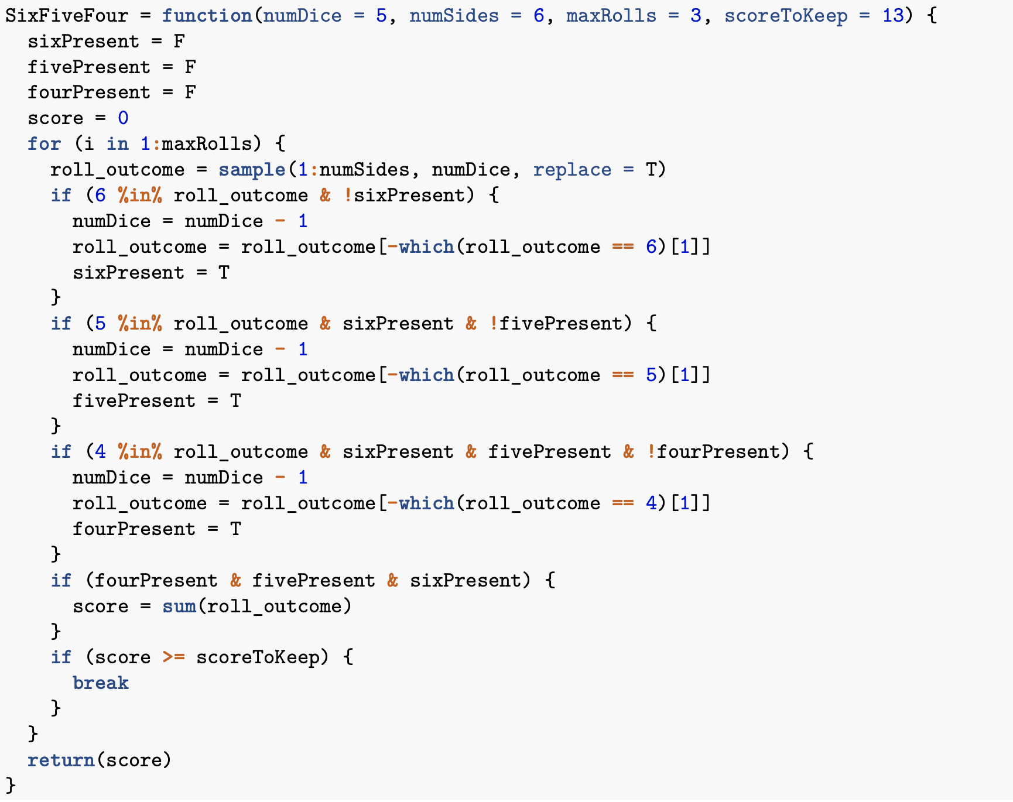
Appendix A: Algorithm in R

Slide 13
Appendix B: Tie handling methods
Option A: One-tie-all-tie
Option B: Roll-off
Option C: Split-the-pot
In my experience, A and B are most common depending on house rules

